Slide 1
Neural Networks
Non-Linear Hypotheses

Slide 2
Why do we need Neural Networks?

Slide 3
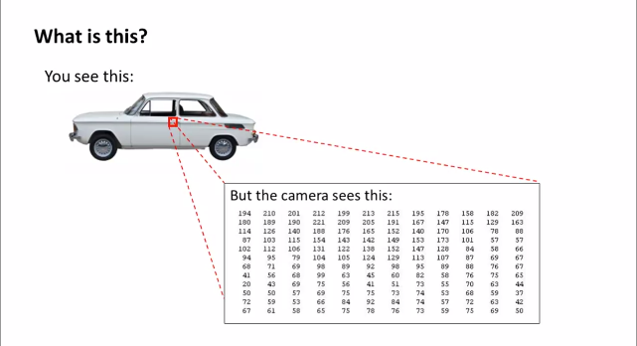
This is what Computers see….

Slide 4
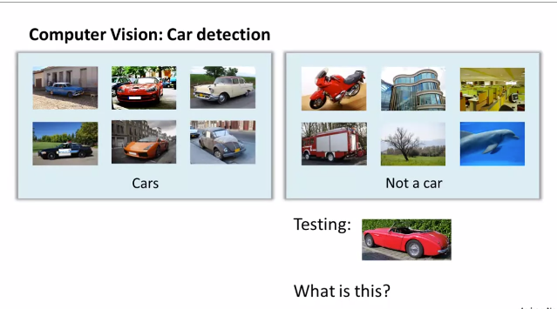

Slide 5
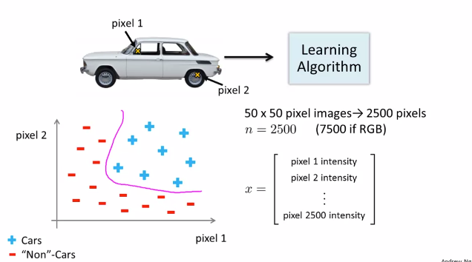
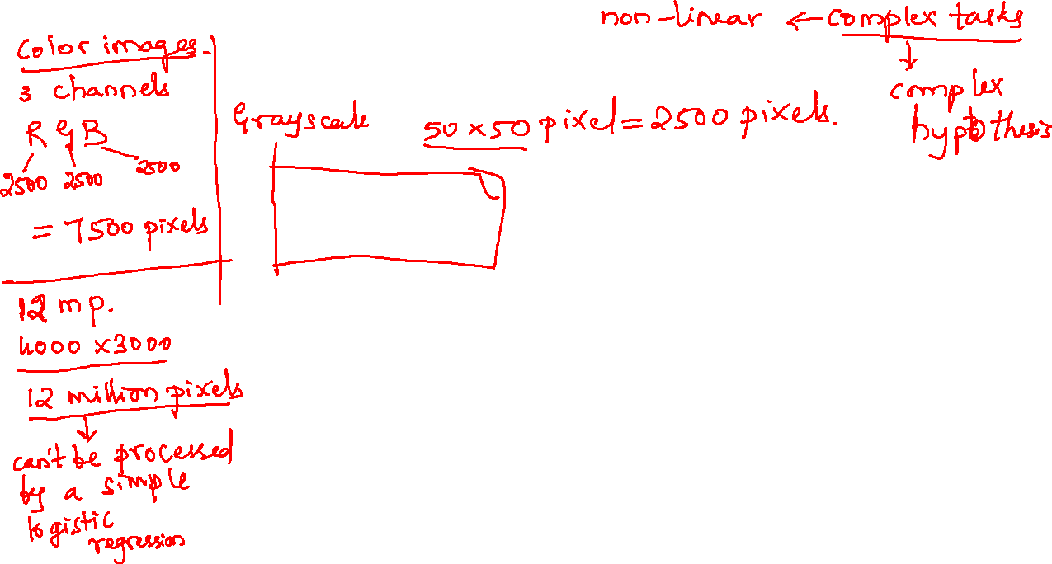
Feature Space Dimension

Slide 6
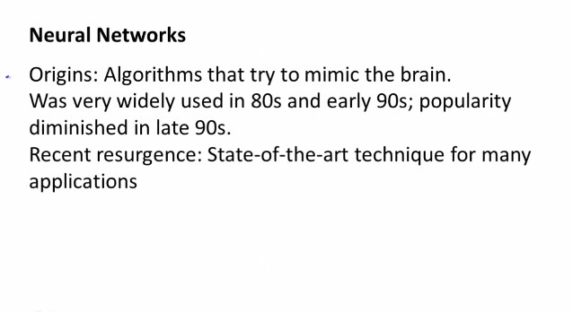
Introduction

Slide 7
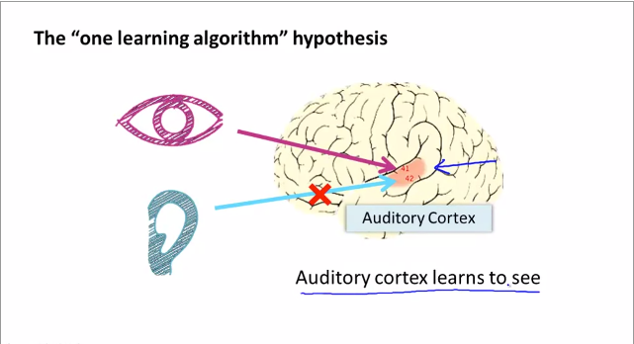
Neurons in Brain

Slide 8
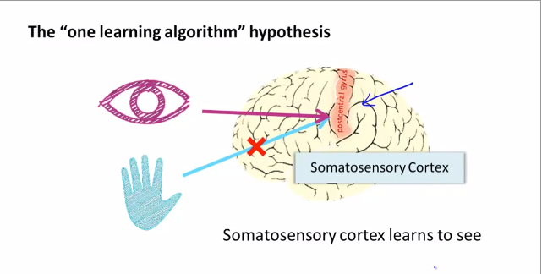
Neurons in Brain

Slide 9
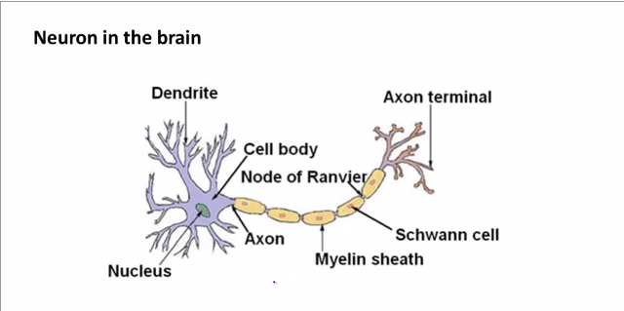
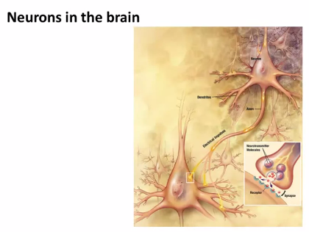
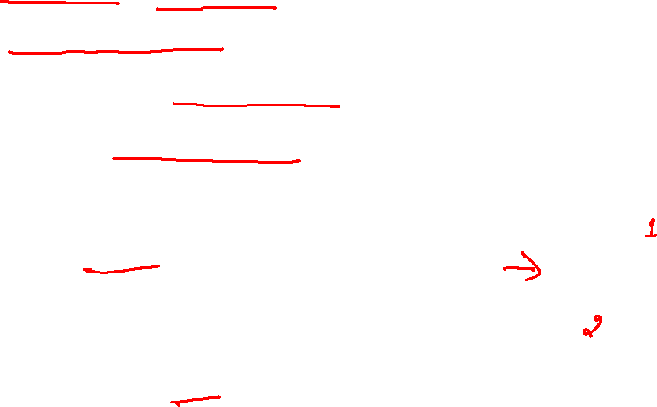
Neurons in Brain
Nucleus – Cell body that computes, produces electric signals.
Dendrite – input signal.
Axon – output signal.

Slide 10
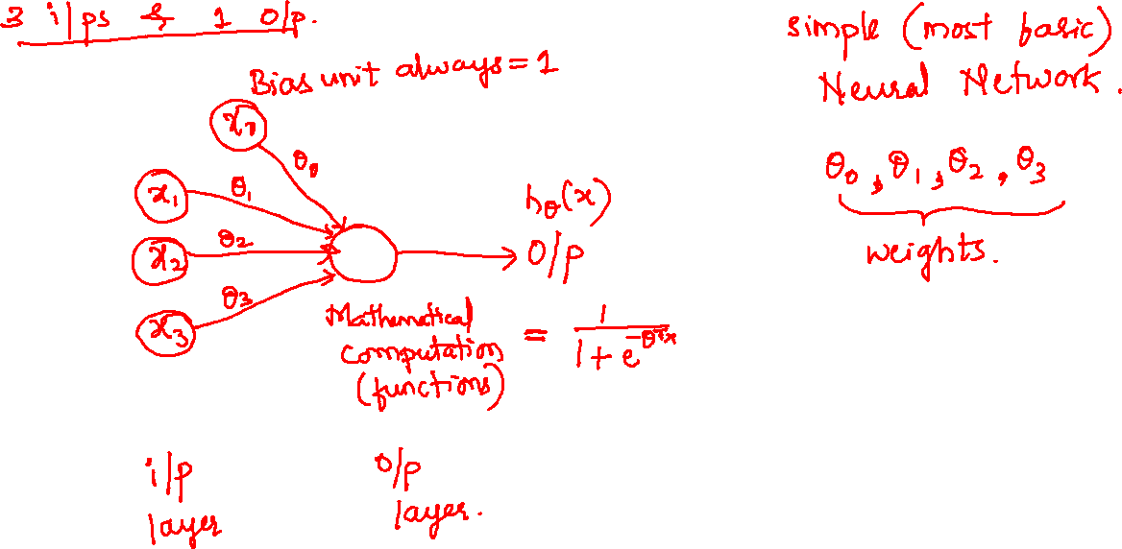

Slide 11
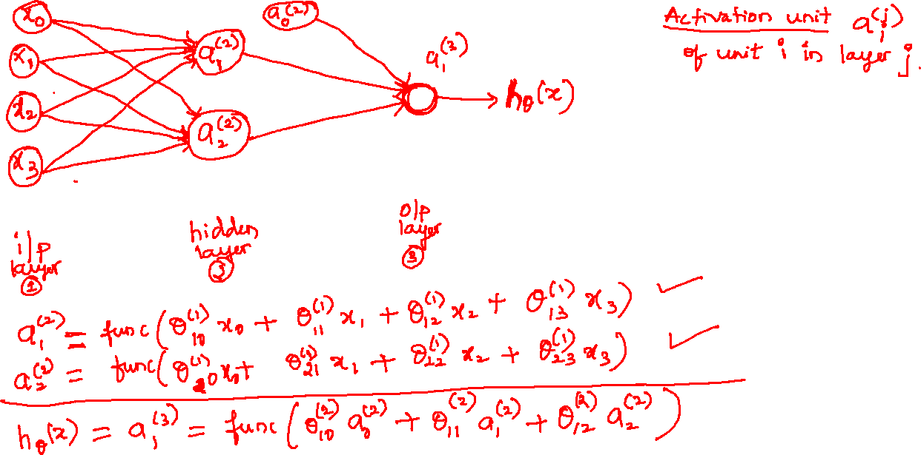

Slide 12
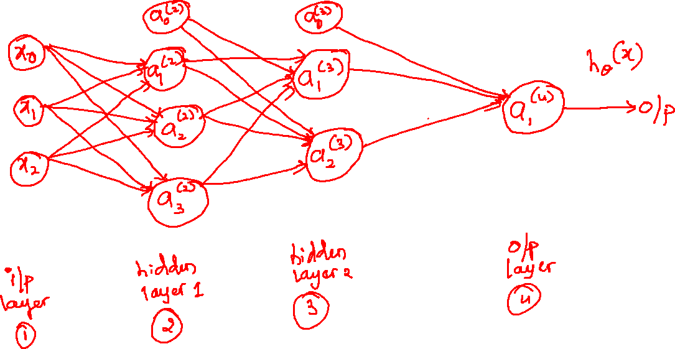

Slide 13
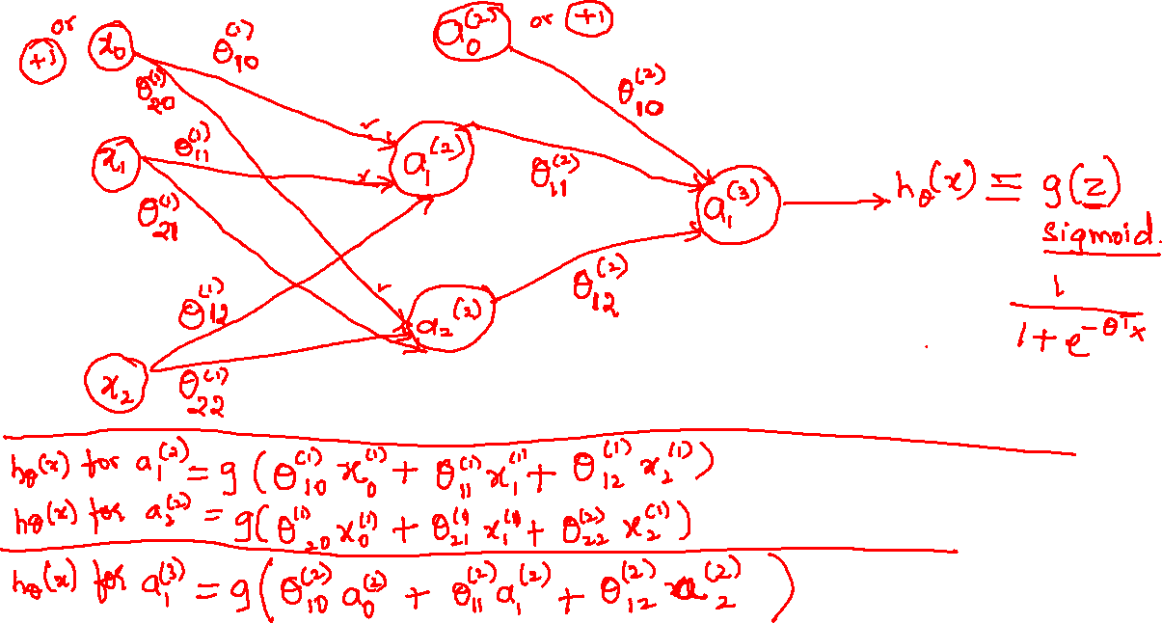

Slide 14
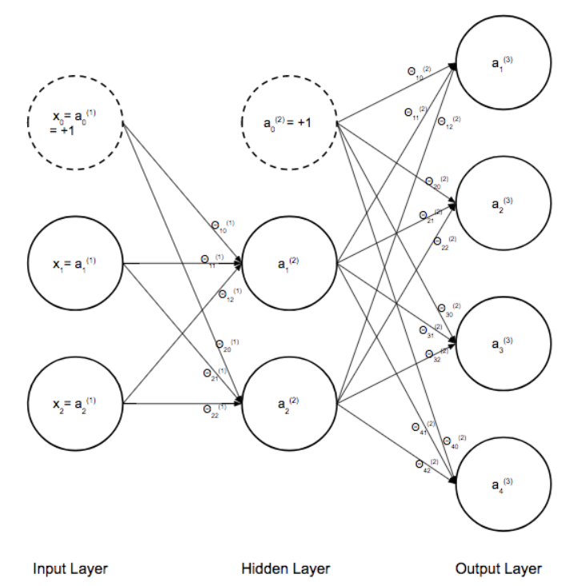
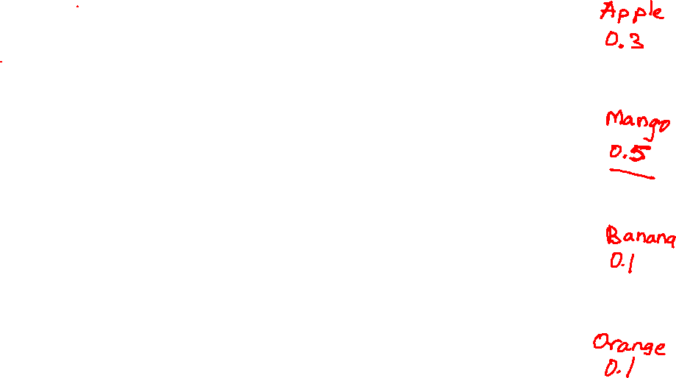

Slide 15
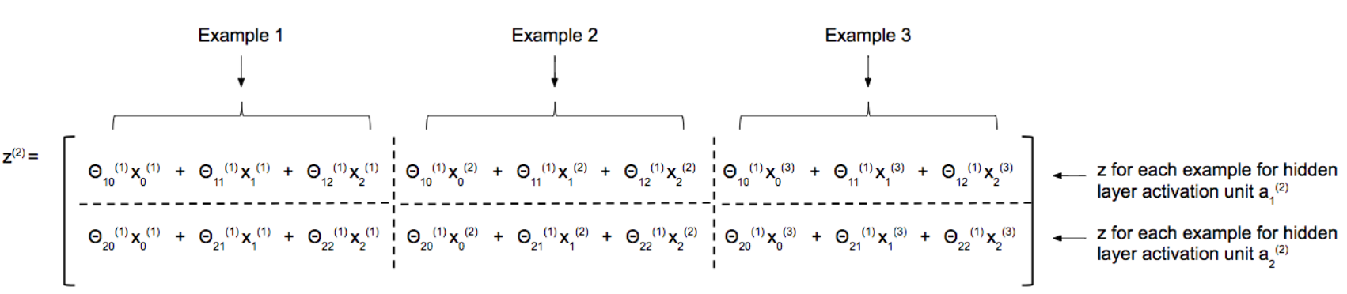

Slide 16
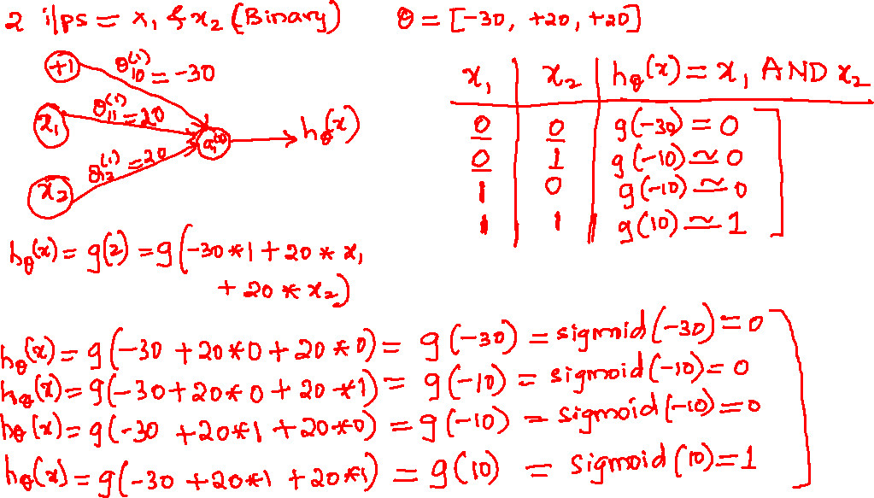

Slide 17
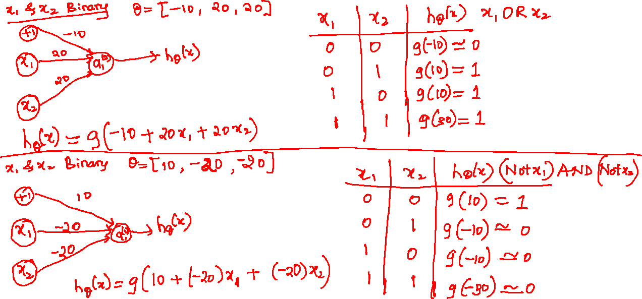

Slide 18
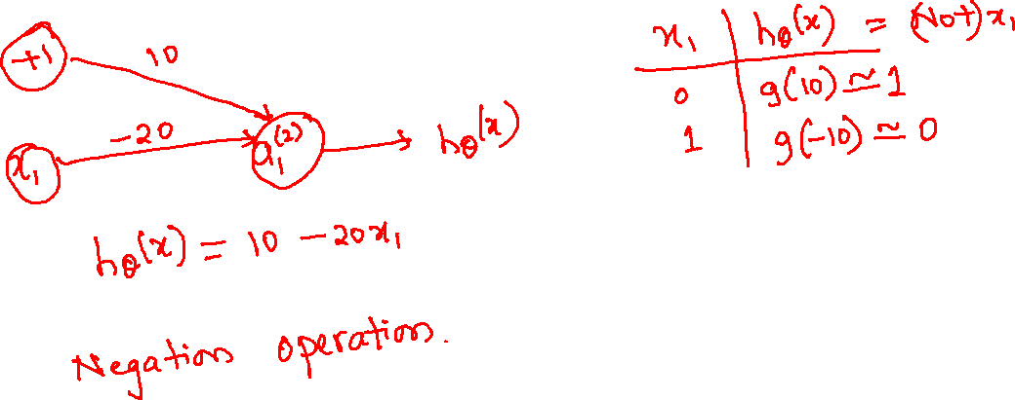

Slide 19
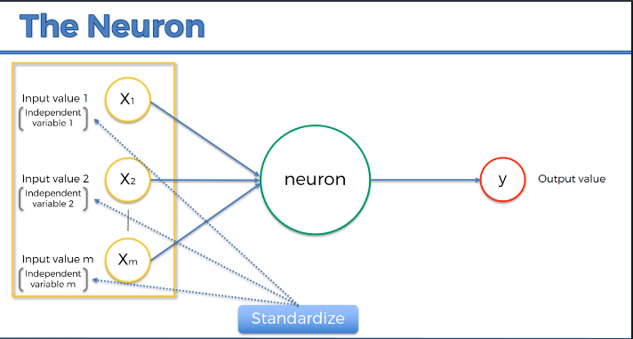
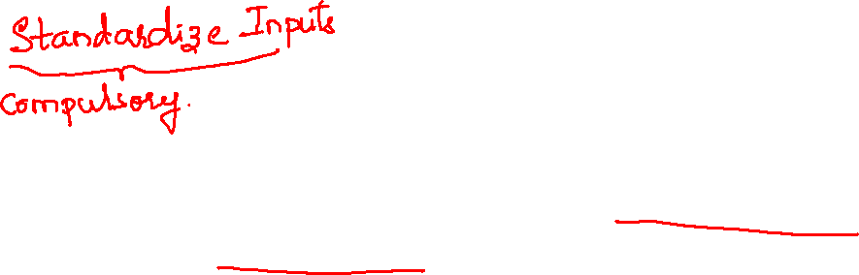
Input Standardization
You need to standardize input values – make sure that they have a mean of zero and a variance one.

Slide 20
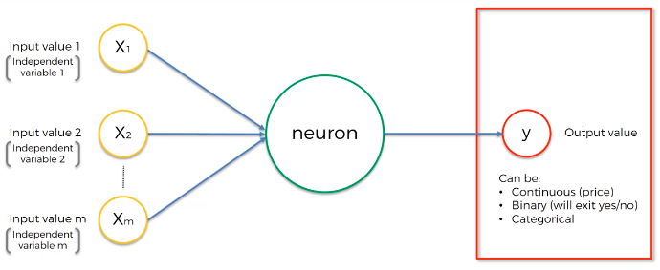
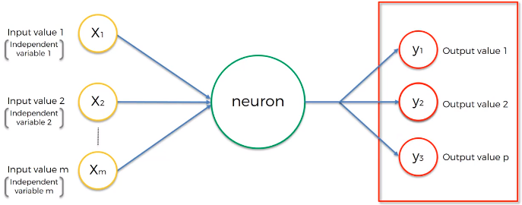
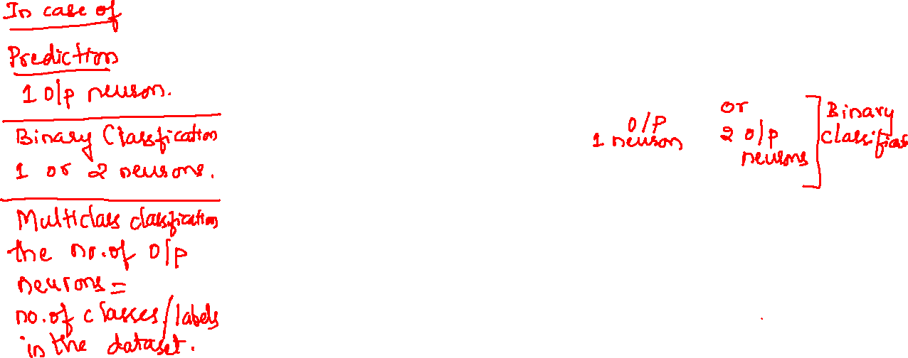
Output Value – y
a

Slide 21
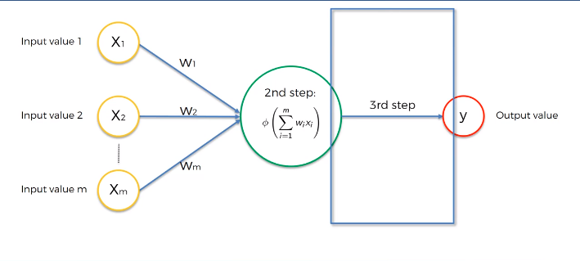
The Activation Function
An activation function in a neural network defines how the weighted sum of the input is transformed into an output from a node or nodes in a layer of the network.

Slide 22
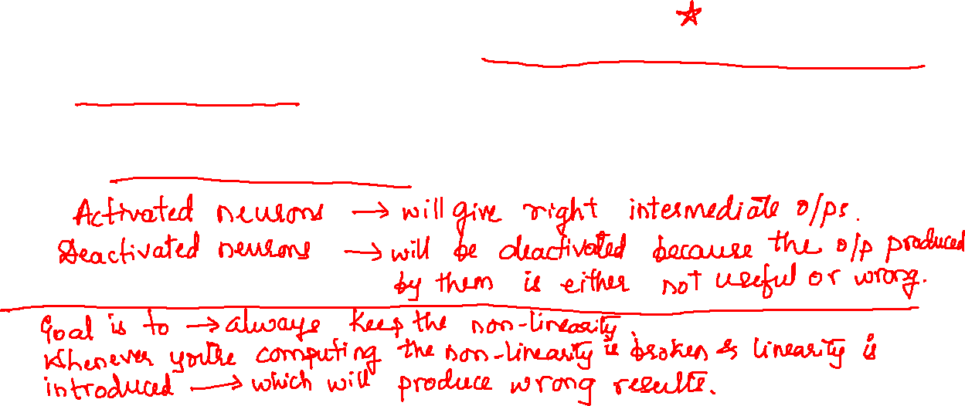
The Activation Function
Activation function decides, whether a neuron should be activated or not by calculating weighted sum and further adding bias with it. The purpose of the activation function is to introduce non-linearity into the output of a neuron.

Slide 23
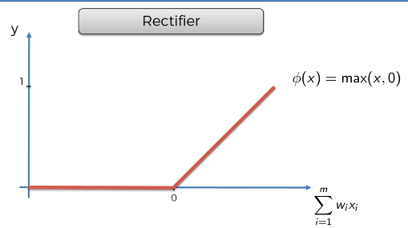
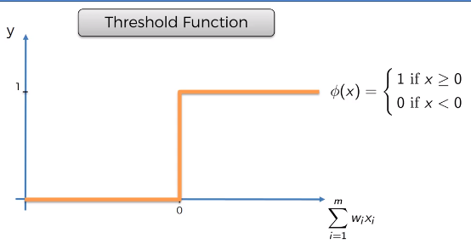
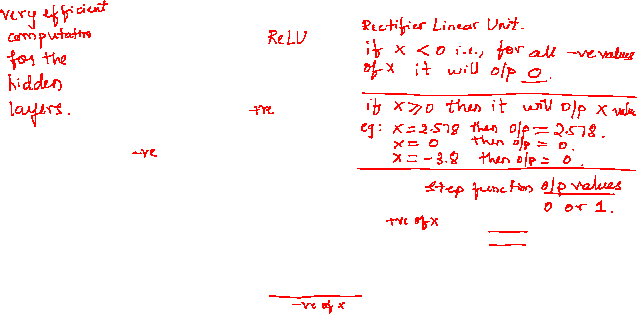
Types of Activation Function

Slide 24
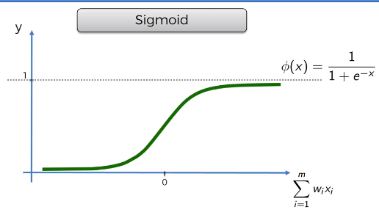
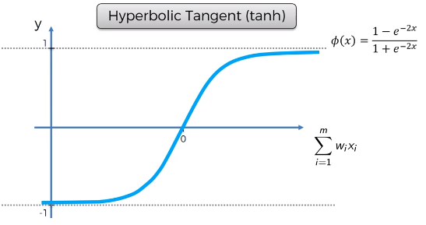
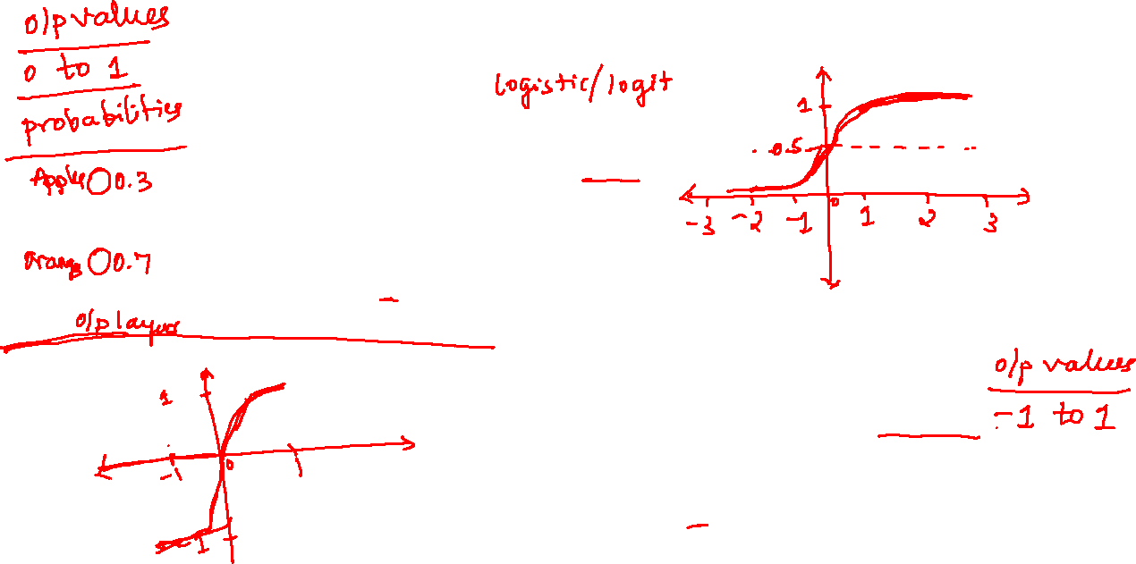
Types of Activation Function

Slide 25
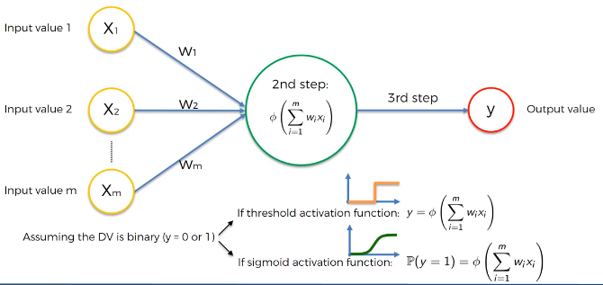
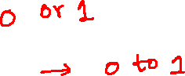
Suppose y is binary (0 or 1), which activation function would you use?

Slide 26
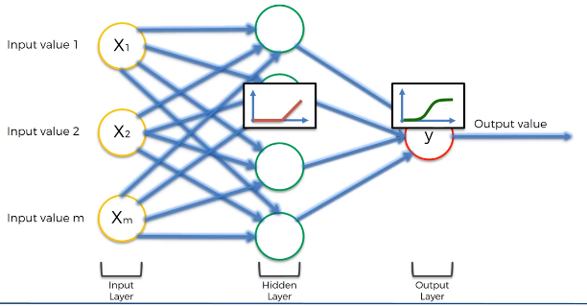
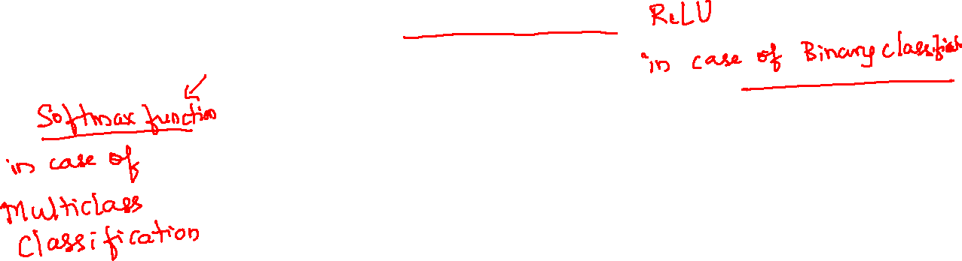
Use of Activation Functions
Hidden layer – Rectifier function
Output layer – Sigmoid function

Slide 27
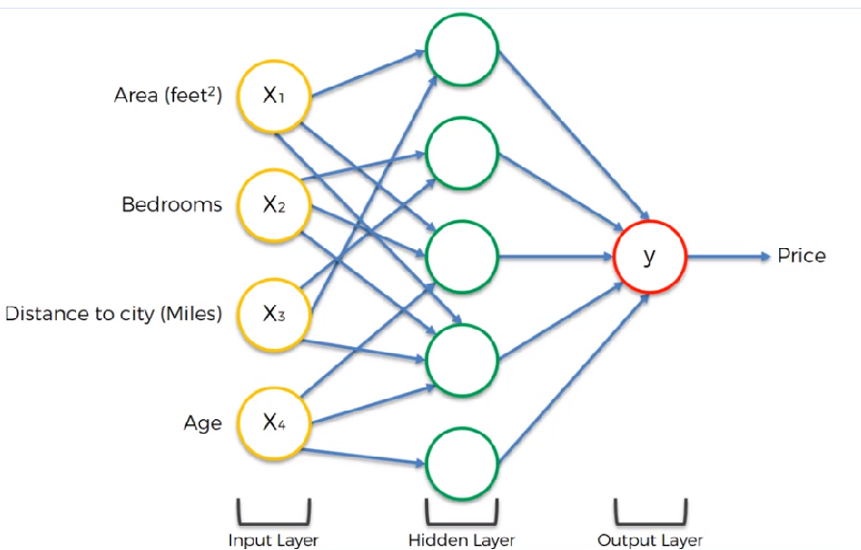
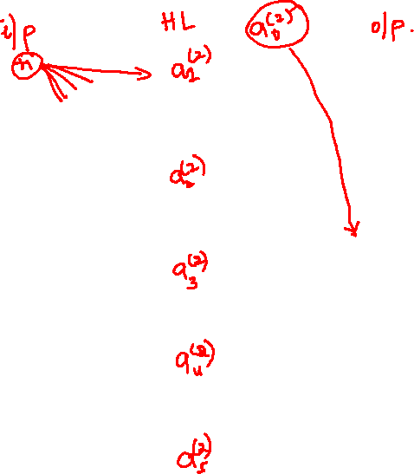
How NNs Work?

Slide 28
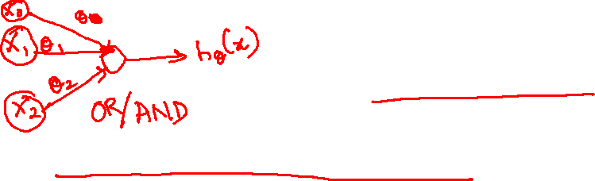
Perceptron
A very basic NN with one layer – Single Layer Feedforward NN (Perceptron).
Perceptron – invented in 1957 by Frank Rosenblat.
Perceptron – something that can actually learn and adjust itself.

Slide 29
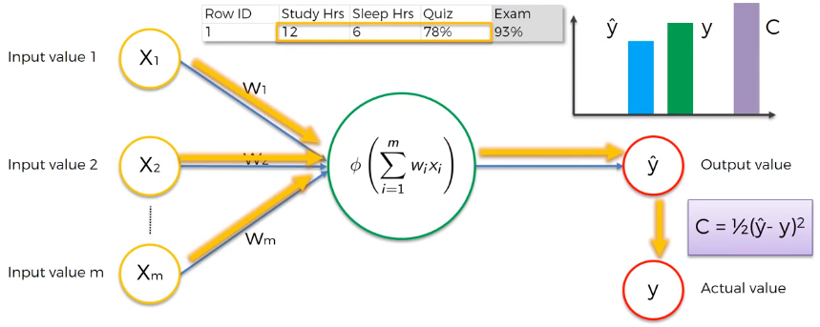
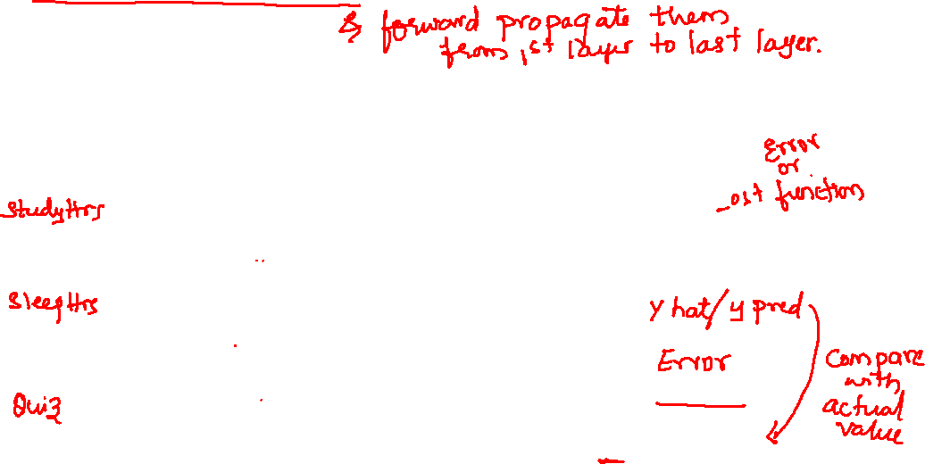
Step 1
Forward Propagation – supply inputs along with initial weights.
Compute Error = ypred – y
Plot the cost function

Slide 30
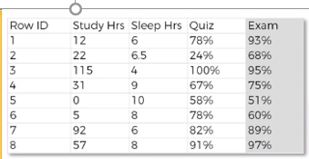
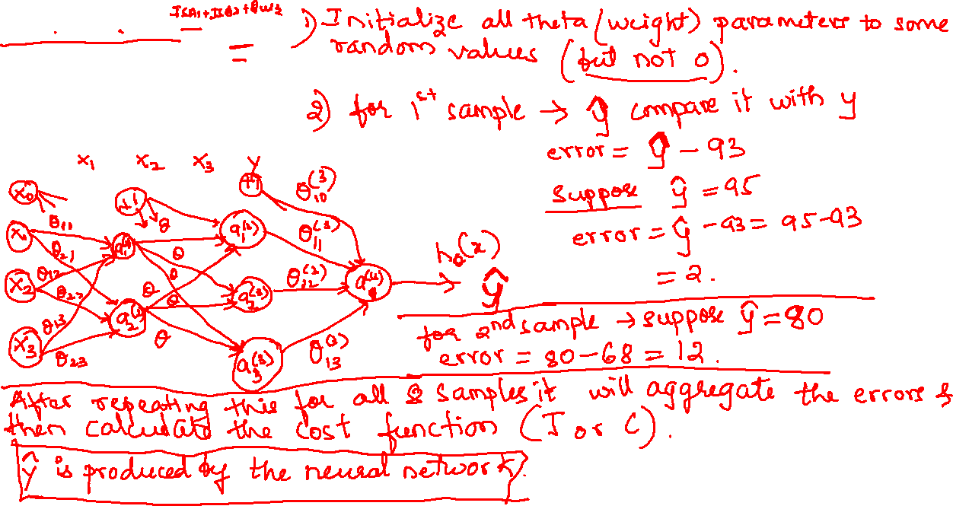

Slide 31
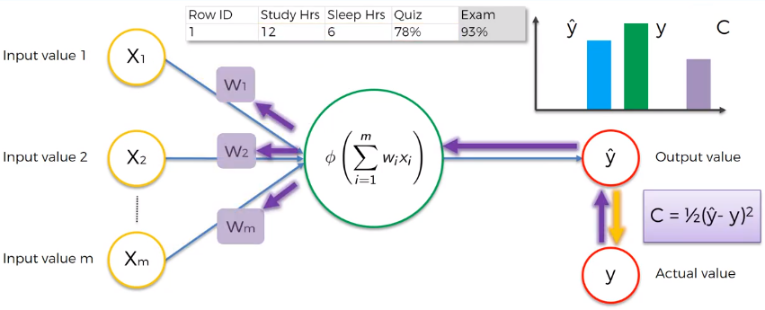
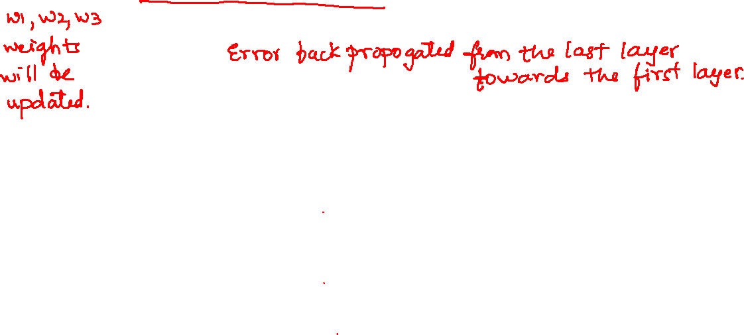
Step 2
Backward Propagation – Update the weights and re-compute the activation function to get new ypred.
Compute error = ypred – y
Plot the cost function.

Slide 32
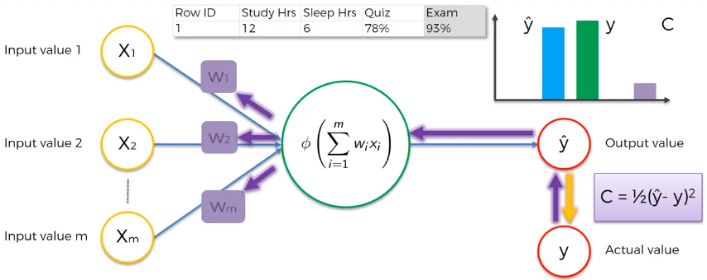
Repeat the process till the cost is nearly 0.
Cost would be nearly 0 when ypred is almost equal to y.

Slide 33
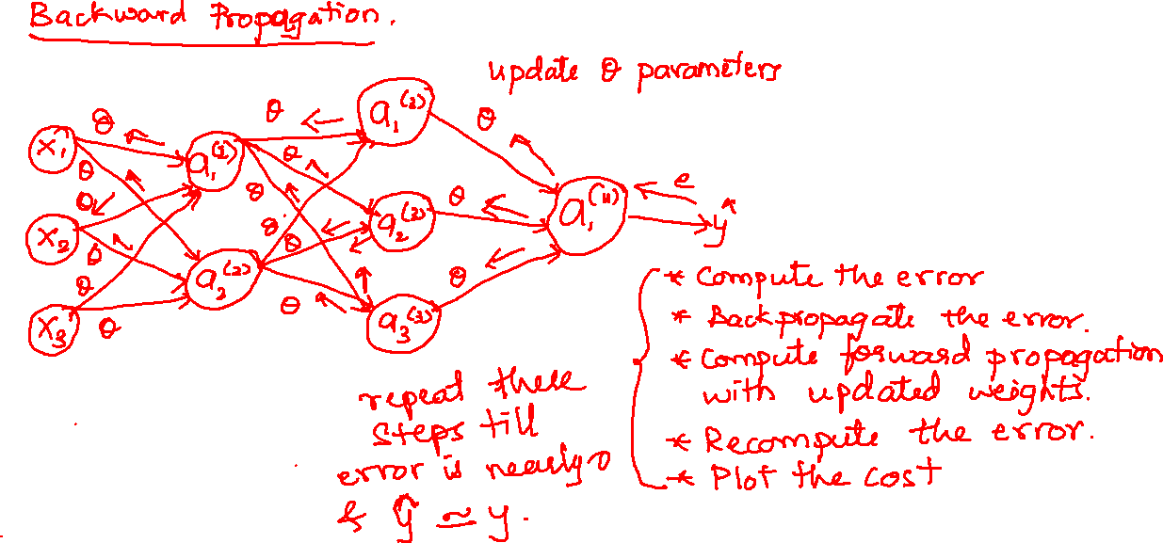

Slide 34
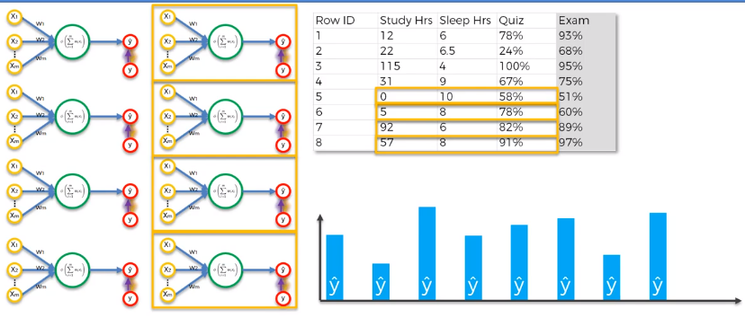
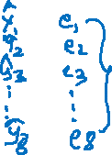
Process illustrated for 8 rows
The figure shows 8 rows of data in the table.
Every row is fed into the same neuron.
For illustration purpose there are 8 neurons shown.

Slide 35

Compute the error for every ypred and y, sum it up and plot the cost function.

Slide 36


Adjust the weights to reduce cost (all rows have same updated weights)

Slide 37


Normal / Batch Gradient Descent
The entire dataset (all rows) is fed one at a time, all ypred are summed up and cost function calculated.
After one epoch (one traverse of entire dataset) weights are adjusted.

Slide 39


Stochastic Gradient Descent
After every row is computed the cost is computed and the weights are updated.
The next row will get the updated weights. This will reduce the cost.

Slide 41

Gradient Descent Vs. Stochastic Gradient Descent

Slide 42
Gradient Descent
Stochastic Gradient Descent
Cannot handle non-convexity. (falls in the trap of local minima).
It is slower in converging as the entire batch has to be run.
Its deterministic – if you have same weights at the start every iteration you get same results.
Handles non-convexity.
Its faster in converging.
More stochastic i.e., random – even if start with same weights, you will pick the rows randomly & adjust the weights. So you would get different results.

Slide 43


Training NN with SGD

Slide 44
Installing Keras
Inside the anaconda prompt, enter the following line command:
conda install -c conda-forge keras

Slide 45

Multiclass Classification using NN

Slide 46


Slide 47

Class/Label Identification

Slide 48

Cost Function

Slide 49

Cost Function
No. of layers in the architecture
additional nested summation that loops through the number of output nodes.
adds up the logistic regression costs calculated for each cell in the output layer
No. of units in layer l
No. of units in layer l+1
The number of columns in our current theta matrix is equal to the number of nodes in our current layer (including the bias unit). The number of rows in our current theta matrix is equal to the number of nodes in the next layer (excluding the bias unit). As before with logistic regression, we square every term.
The triple sum simply adds up the squares of all the individual Θs in the entire network.

Slide 50


Zero Initialization of θ Parameters
You can’t initialize all parameters to zero.
In the above figure the parameters in blue, red, green all have same values. Hence the activation units a₁⁽²⁾, a₂⁽²⁾ will be computing the same function of your inputs.
After each update, parameters corresponding to inputs going into each of the two hidden units a₁⁽²⁾, a₂⁽²⁾ are identical (for every training examples: a₁⁽²⁾ = a₂⁽²⁾ ).
This is because the derivatives w.r.t θ₀, θ₁ are also same after every iteration.

Slide 51
Zero Initialization of θ Parameters
As a result the NN will learn only one feature rather than learn anything interesting.
When we backpropogate, all nodes will update to the same value repeatedly. The error will not be reduced.
Suppose there many hidden units, then, all the units will compute the exact same function of the input.
The logistic (sigmoid) function unit in the output layer will see only one feature as all hidden units input the same values to it.

Slide 52

Random Initialization
The problem of Zero initialization in NN is referred to as Symmetry Weights (all weights are being same).
To break the symmetry we can randomly initialize our weights for our Θ matrices – initialize each Θ^{(l)}_{ij} to a random value between[−ϵ,ϵ].
rand(x,y) function will initialize a matrix of random real numbers between 0 and 1.
Eg: theta1 = rand(10, 11) * (2*epsilon) – epsilon. This will initialize a matrix of 10 X 11 with random numbers between 0 and 1.

Slide 53
Random Initialization
Consider this procedure for initializing the parameters of a neural network:
Pick a random number r = rand(1,1) * (2 * INIT_EPSILON) - INIT_EPSILON;
Set Θ(l)ij=r for all i,j,li,j,l
This fails to break the symmetry of weights.

Slide 54


Building a Neural Network
First pick a network architecture –
No.of input units = Dimension of features x(i)
No.of output units = No.of classes
Hidden layers: default is 1, if you have >1 hidden layers then have same no.of hidden units in every layer (the more the hidden units better will be the result though, that increases computation cost)
The no.of hidden units should be compatible with the no.of units in the input layer. Eg: if there are 3 i/p units then you can have two times, three times or four times (i.e., 6, 9 or 12) units.
The o/p layer units will produce the result in the form of binary number vector. Eg: if an i/p is classified as 4th class then the vector will be {0,0,0,1} i.e., only the fourth unit will have 1 while other 3 units will have 0.
0
0
0
1

Slide 55


Training a Neural Network
Randomly initialize the weights
Implement forward propagation to get hΘ(x(i)) for any x(i)
Compute the cost function J($θ$)
Implement backpropagation to compute partial derivatives $∂/∂θl$_{jk}J($θ$)
For i = 1:m
Perform FP & BP using i/p example (x^{(i)}, y^{(i)})
Get activations a^{(l)} & delta terms (error) $∂$^{(l)} for l = 2, ….., L

Slide 56

Training a Neural Network
Use gradient checking to confirm that your backpropagation is working properly. Then disable gradient checking.
Use gradient descent or a built-in optimization function with BP to minimize the cost function with the weights in theta.
Gradient Descent computes the partial derivatives while BP takes the direction in downhill.
The cost function J(θ) is non-convex. Hence it might get stuck in local minima. But techniques like gradient descent ensure that J(θ) is minimized.

Slide 57
Mapping Steps to Program
The dense function will randomly initialize the weights of each nodes to a number close to 0.
Number of nodes in the input layer = number of features.
Propagation – left to right the neurons are activated by the activation function. If particular neuron(s) will have higher activation function value then it will have more impact on the network. This means it will pass more signal from left to right nodes.

Slide 58
Mapping Steps to Program
The activation function used here will be rectifier function for hidden layers.
The sigmoid function is best suited for output layer as it gives us the probabilities for every data point. This can be used only if the outcome is binary (0 or 1).
In case of One Vs. All method ( more than two categories) then we use Softmax activation function in place of sigmoid function.

Slide 59



Slide 60



Slide 61

Correct & Incorrect Predictions

Slide 62


Correct Predictions

Slide 63


Incorrect Predictions

Slide 64


Type of Errors

Slide 65



Slide 66



Slide 67



Slide 68

Skewed Classes
Suppose you build a ML model to classify patients with cancer & without cancer.
Your hypothesis h() is y=1 if cancer & y=0 if no cancer.
You get a 1% error on test set i.e., 99% accuracy.
But you find that the reality is only 0.50% of patients have cancer. (eg- out of 1000 only 5 are positive)
Skewed classes – the number of positive examples is much, much smaller than the number of negative examples (y = 1 so rarely).

Slide 70

Classification Accuracy???
Suppose you have a classifier that gives 99.2% accuracy. You make some changes & further get 99.5% accuracy. So the error reduces from 0.8% to 0.5%.
Using single number metrics might be easy but unreliable.
In case of very skewed classes it is very hard to use just accuracy because you might have high accuracies with low errors & still not always sure of the quality of the classifier.
So its important to use other evaluation metric.

Slide 71

Precision / Recall
y = 1 is very rare (skewed class).
Precision – of all patients where we predicted y=1, what fraction actually has cancer?
TP / #Predicted POS = TP / (TP + FP)
Recall – of all patients that actually have cancer, what fraction did we correctly detect as having cancer? TP / #Actual POS = TP / (TP+FN)
Actual Class | Predicted Class
 |  | 0 | 1
 | 0 | TN | FP
 | 1 | FN | TP

Slide 72


Precision / Recall (another example)
Suppose we go for fishing & want to catch all the red fish.
Precision – whenever we catch a fish it is red. Say we caught 17 fish out of which only 6 are red. Our precision would be: 6/17 = 35%.
Recall – if there are 8 red fish in the pond and we manage to catch only 6. Our recall is: 6/8 = 75%.

Slide 73

Precision-Recall Tradeoff
When we try to increase precision recall decreases and vice-versa.
In case of skewed data, depending on the requirement we can either build recall-focused or precision-focused model.
In other cases where we want to increase both then we can go for F1 Score (F score).
F1 score gives us an optimal blend of both precision and recall (harmonic mean of P & R as it punishes the extreme values).
F1 = 2 * ( P * R ) / ( P + R )

Slide 74
Support Vector Machine
(SVM)

Slide 75



Lines of Separation

Slide 76

Support Vectors, Maximum Margin

Slide 77


How do usual Machine Learners work?
Suppose you are training a model to identify apples and oranges.
Usually the common machine learners look for objects that are very close to apples/oranges. That is, they learn from the similarity patterns.

Slide 78

How do SVMs work?
SVMs look for apples that are more like oranges
And
For oranges that are more like apples
This essentially means SVMs learn from the dissimilar patterns. Using this knowledge they construct the margin that would be the decision boundary for separation of classes.

Slide 79
a

